Slide 1
BARCELONA

Slide 2
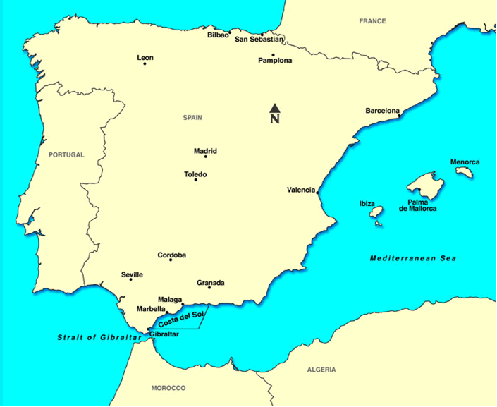
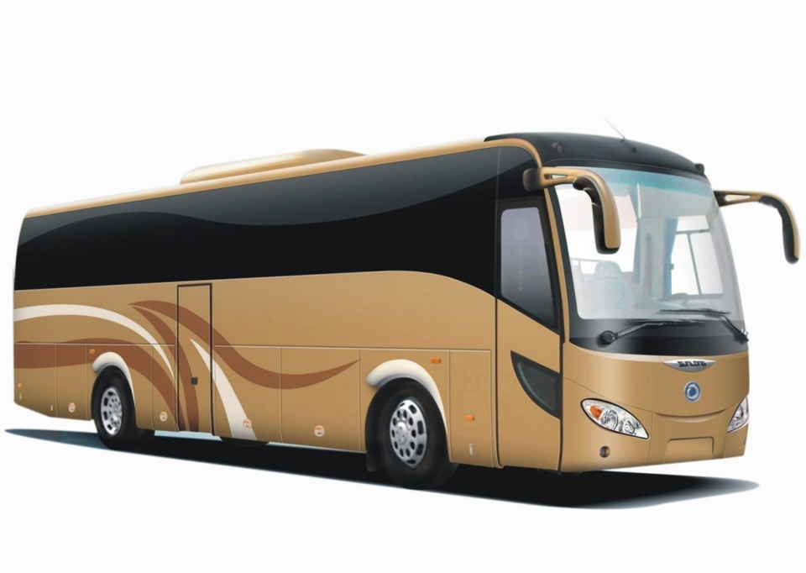
*Tarragona

Slide 3
Guided Sightseeing Tour in BARCELONA

Slide 4
Park Guell

Slide 5
La Sagrada Familia

Slide 6
Olympic Stadium

Slide 7
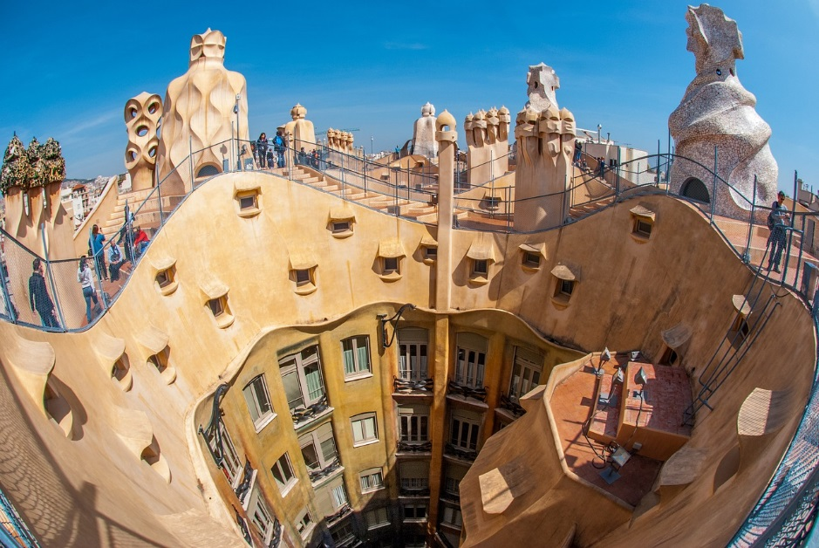
Casa Mila

