Slide 1
MADRID

Slide 2
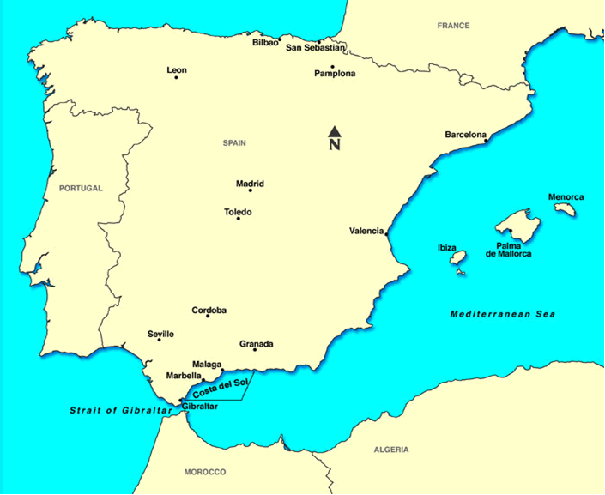

Slide 3
Guided Sightseeing Tour in MADRID

Slide 4
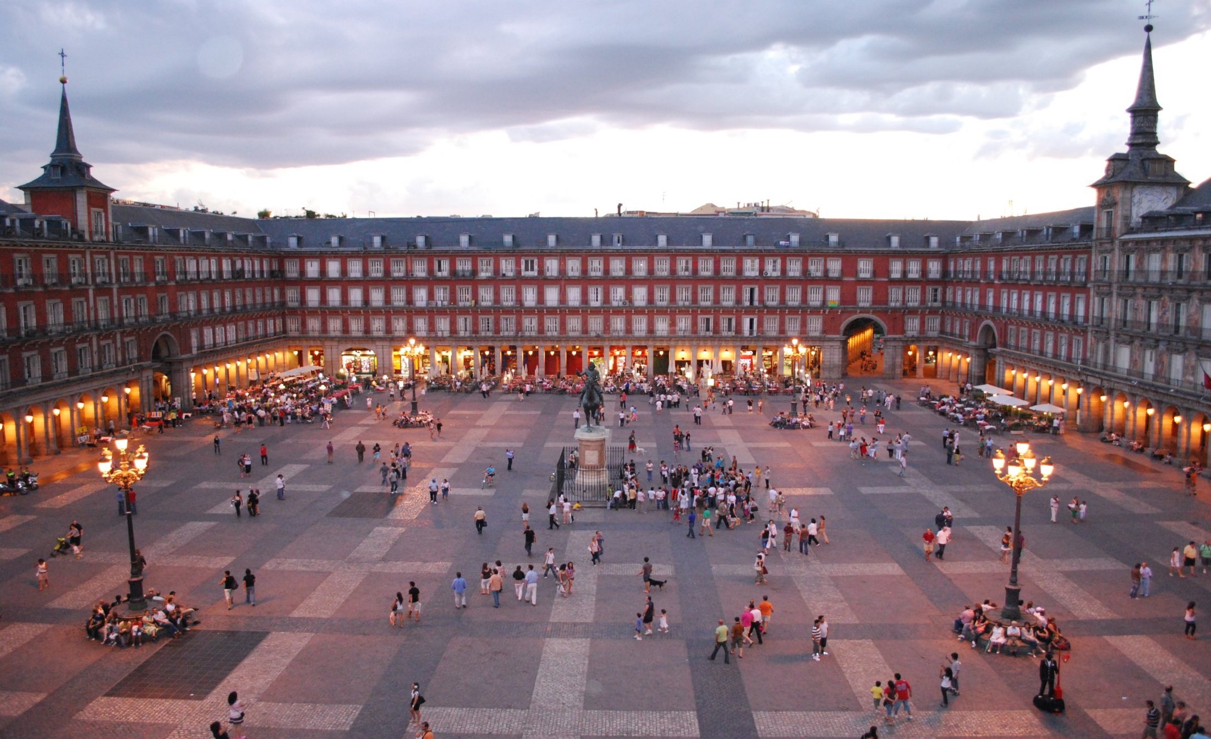
Plaza Mayor

Slide 5
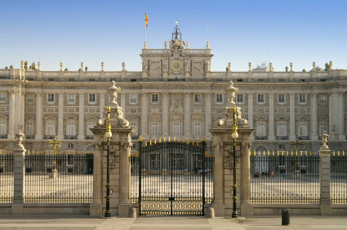
Royal Palace

Slide 6
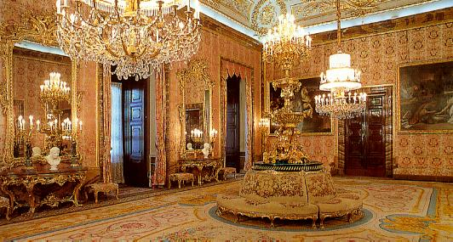

Slide 7
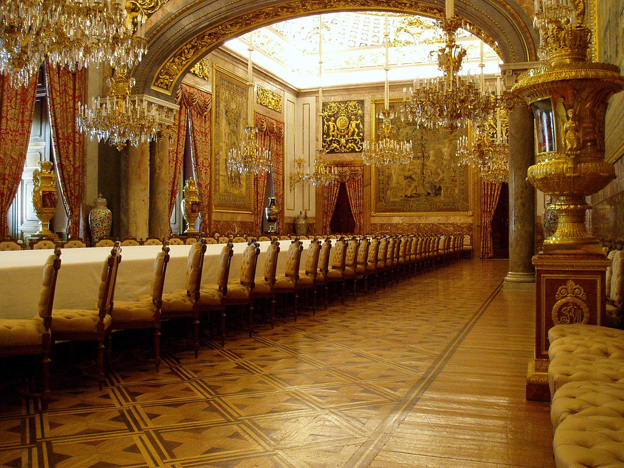

Slide 8
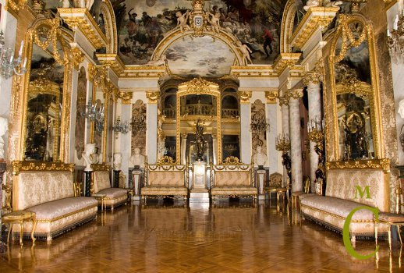

Slide 9
Prado – National Art Museum( 12th – 20th century)

Slide 10
F. Goya

Slide 11
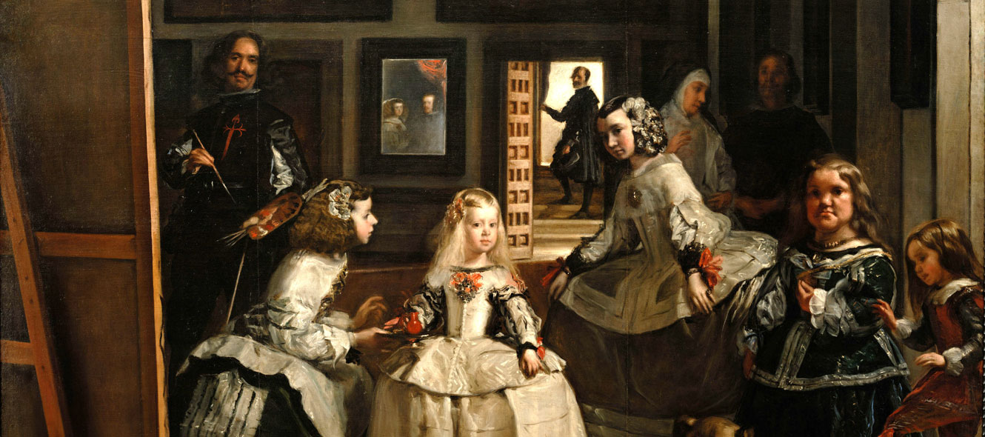
D. Velazquez

Slide 12
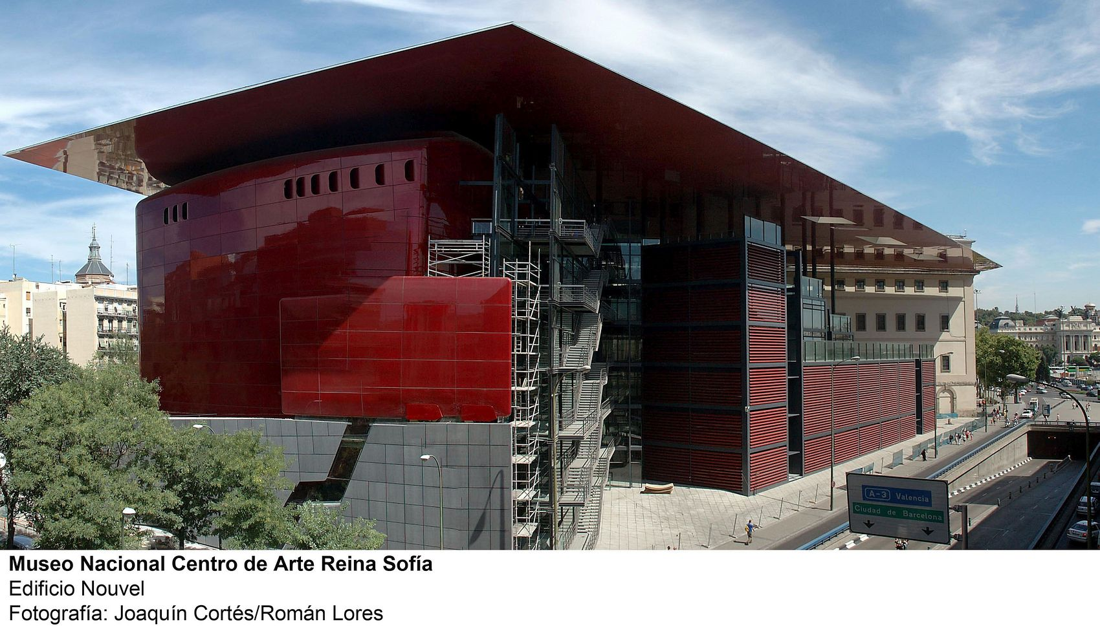
Reina Sophia - National Museum of 20-th century art

Slide 13
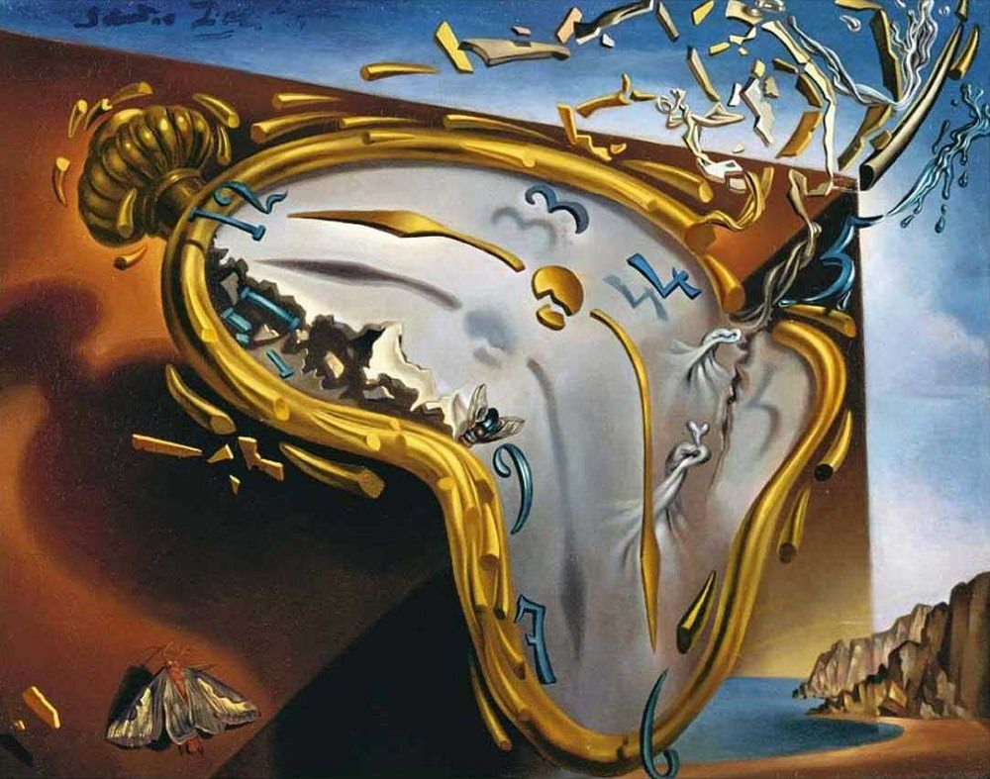
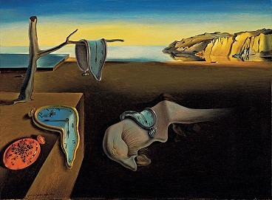
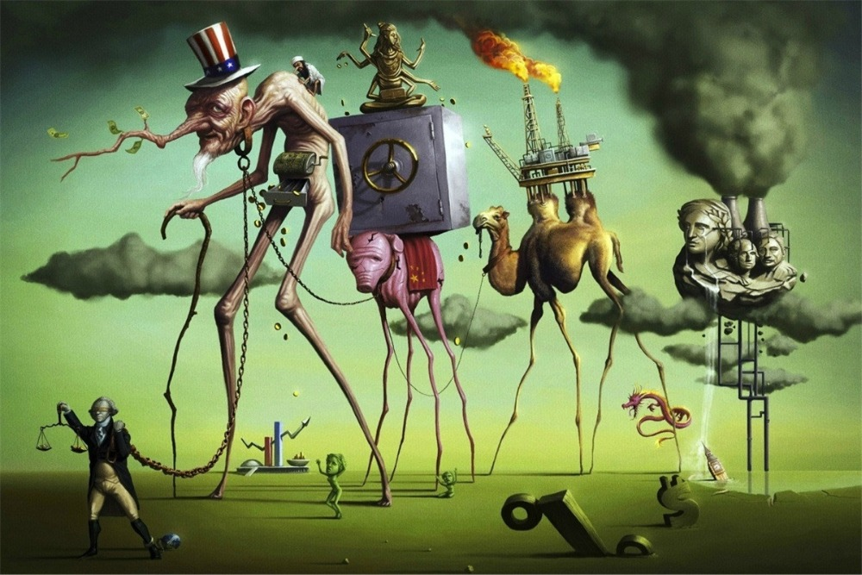
S. Dali

Slide 14
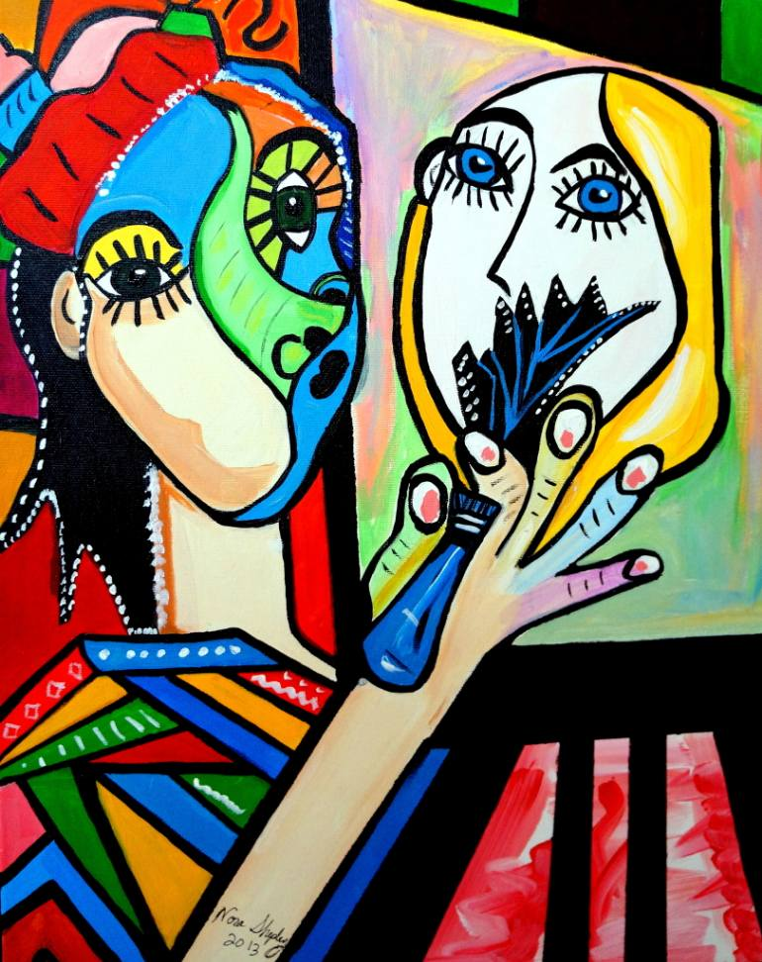
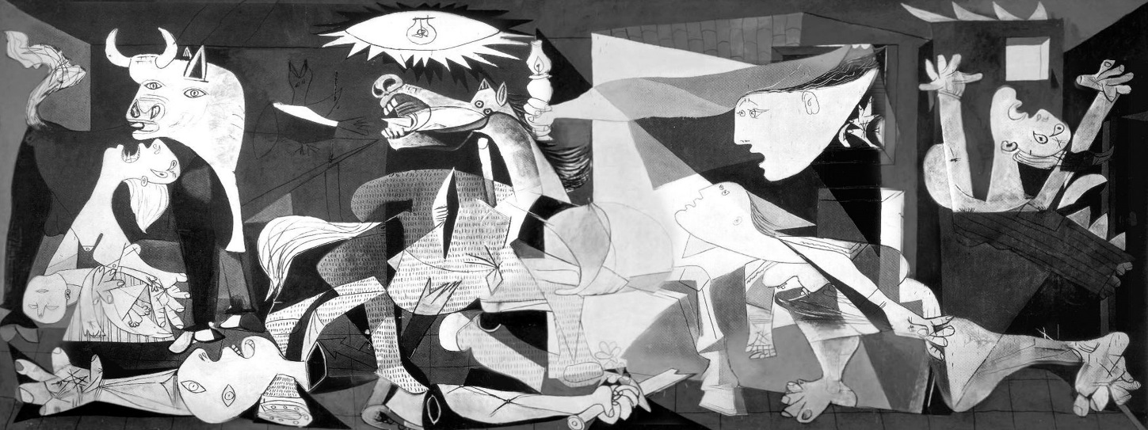
P. Picasso

Slide 15
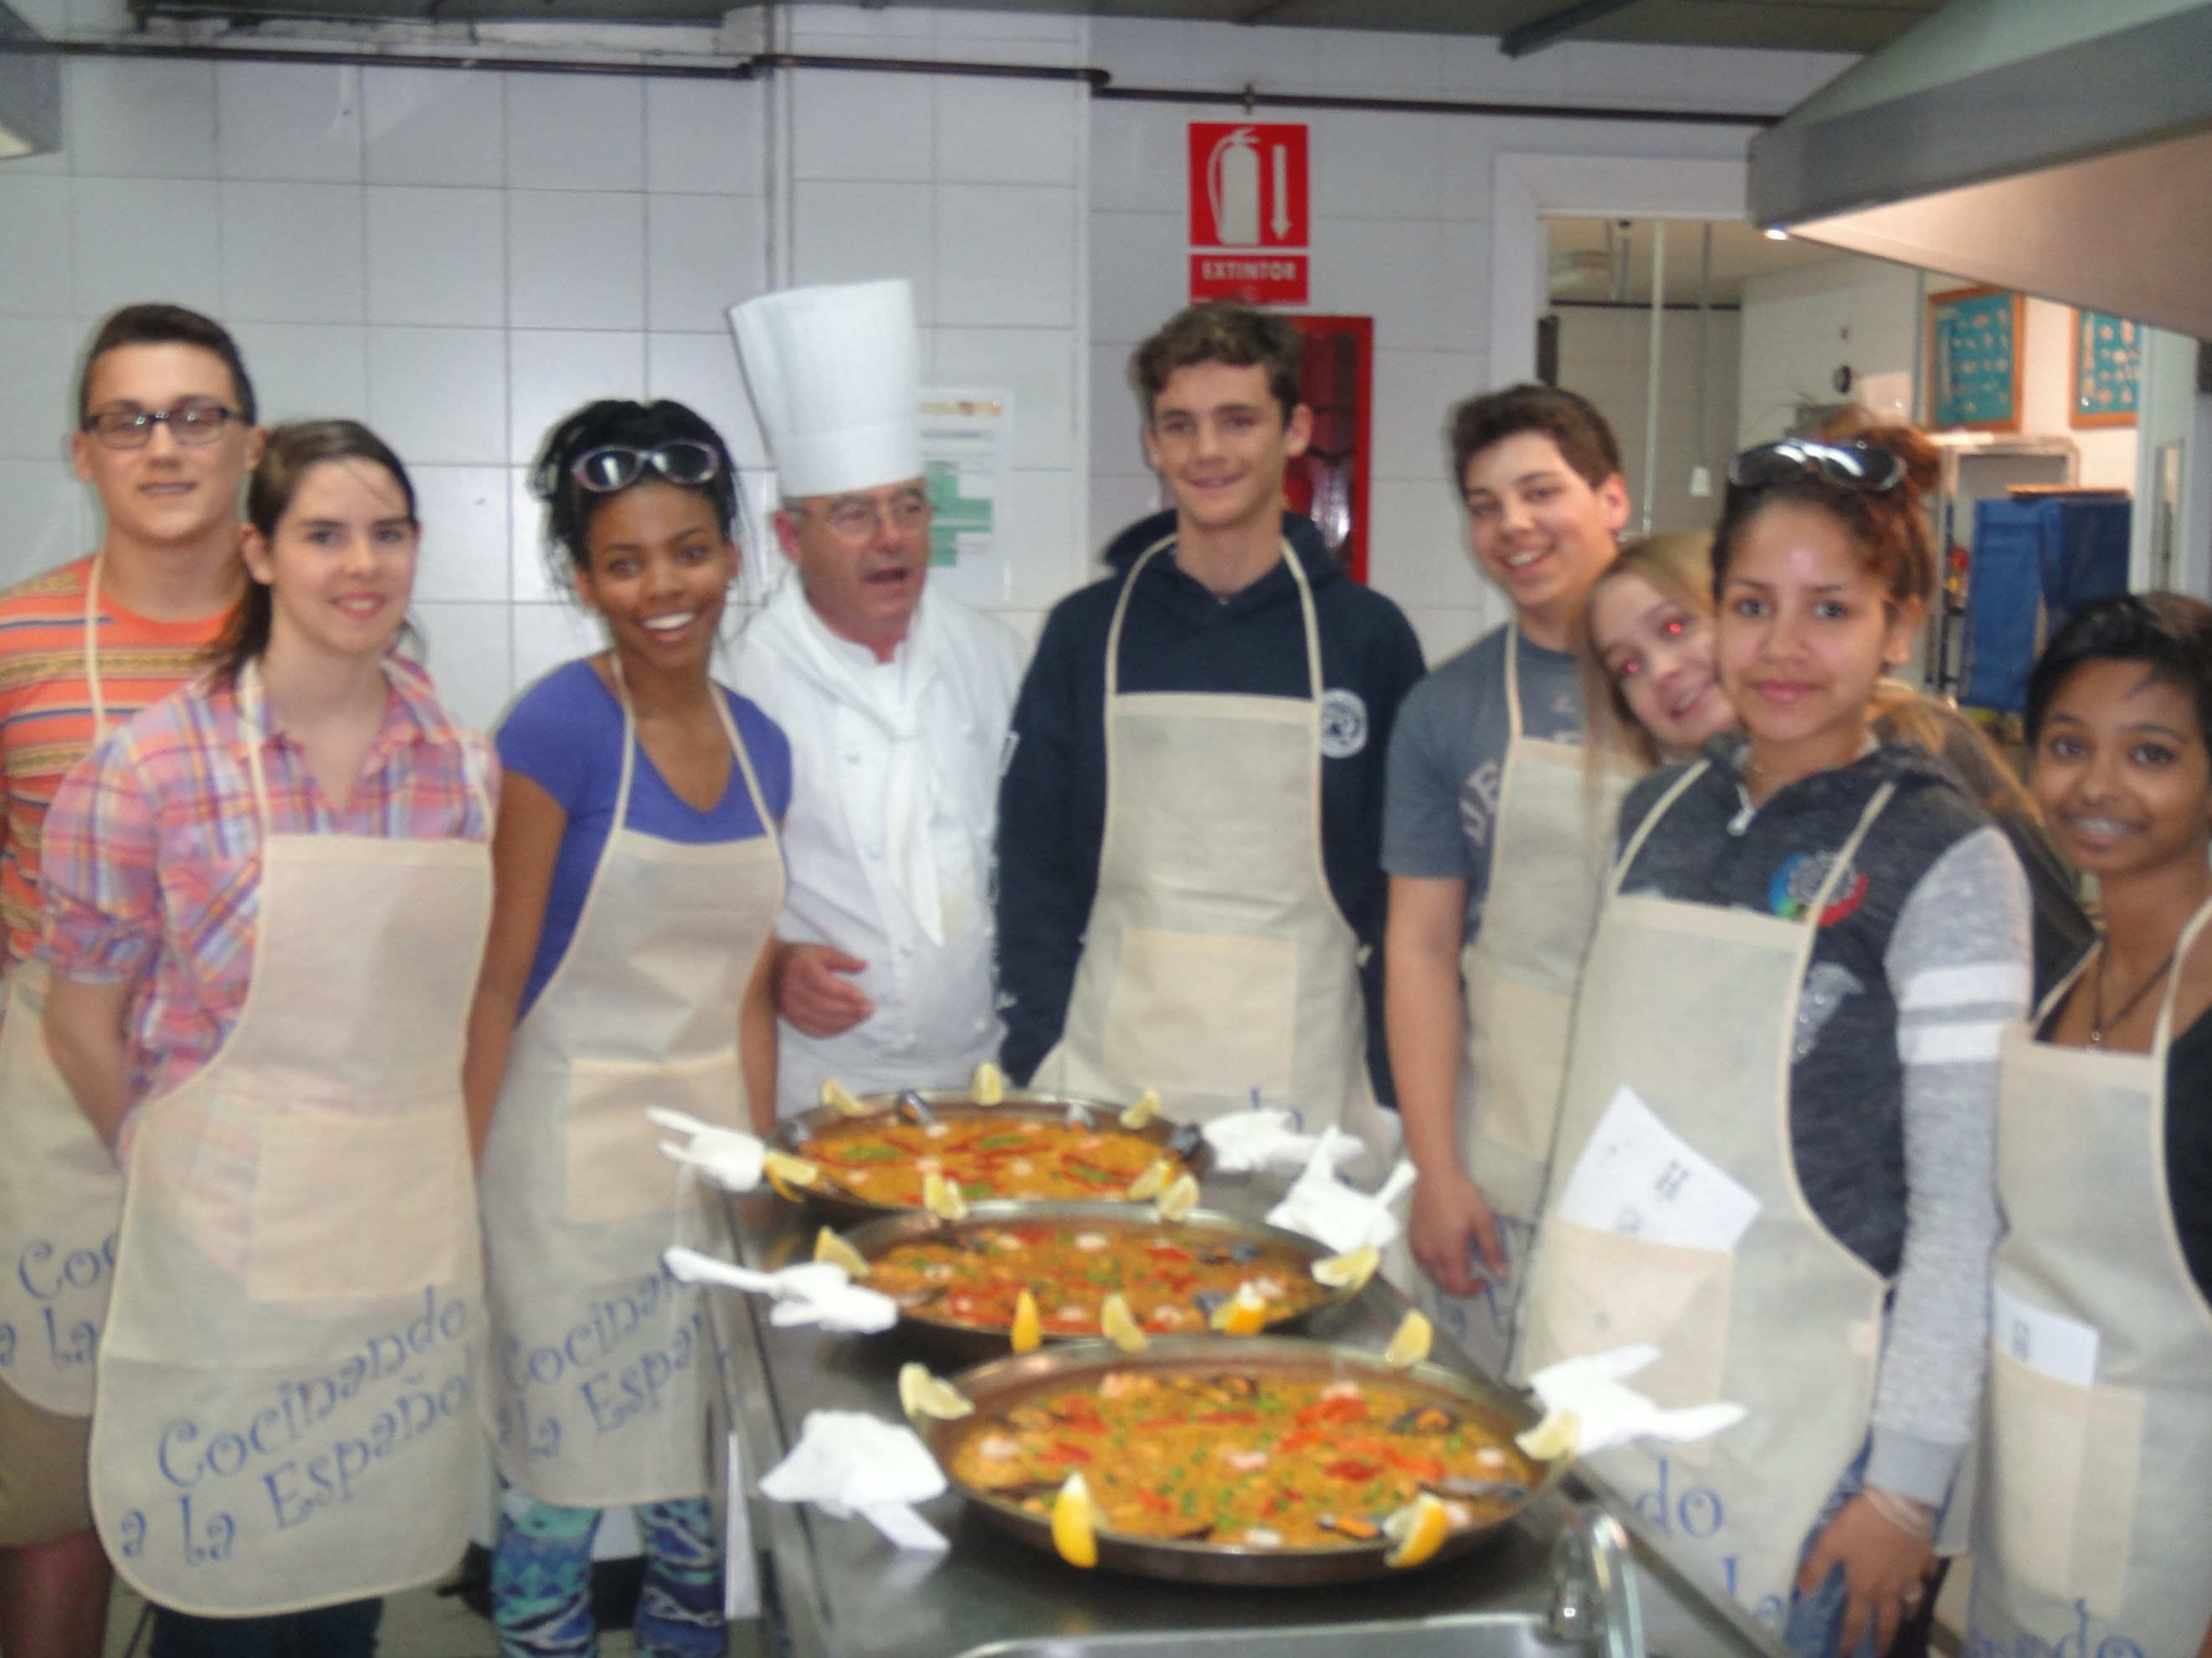
La Cocina Española - you cook, then you eat ☺

Slide 16
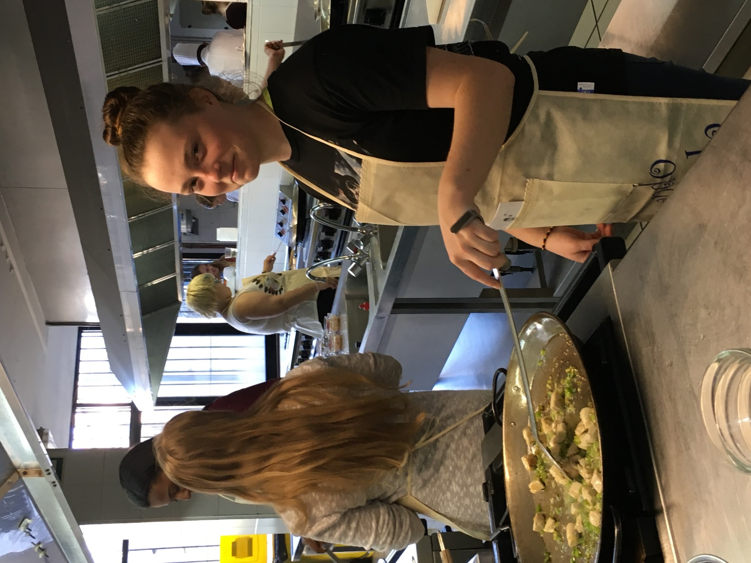

Slide 17
