Slide 2
TOLEDO

Slide 3
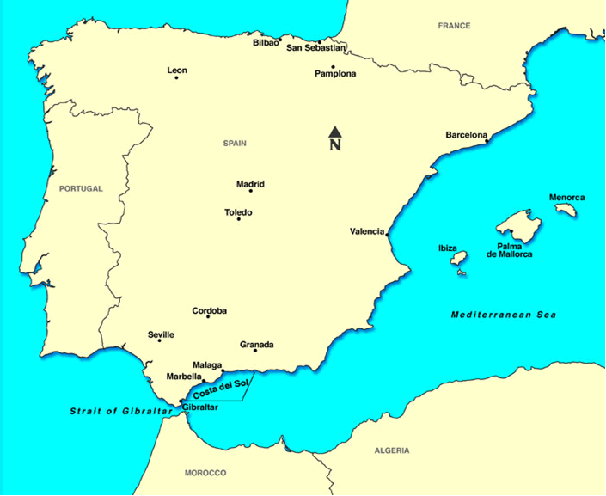

Slide 4
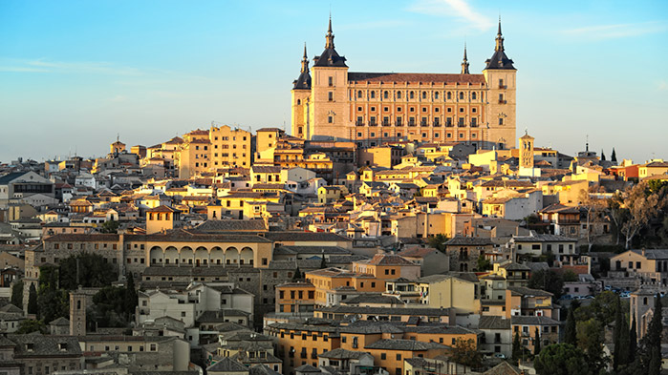
Capital of the province of Toledo
declared a World Heritage Site by UNESCO
Known as
-“Imperial city”
( the main venue of the court of Charles V)
- The city of 3 cultures
(historical co-existence of Christians, Muslims and Jews)
TOLEDO

Slide 6
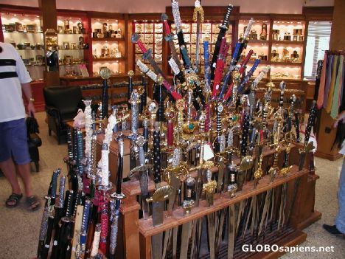
Toledo has a history in the production of bladed weapons, which are now popular souvenirs of the city.

Slide 7
Visit the sword factory, then the store

Slide 8
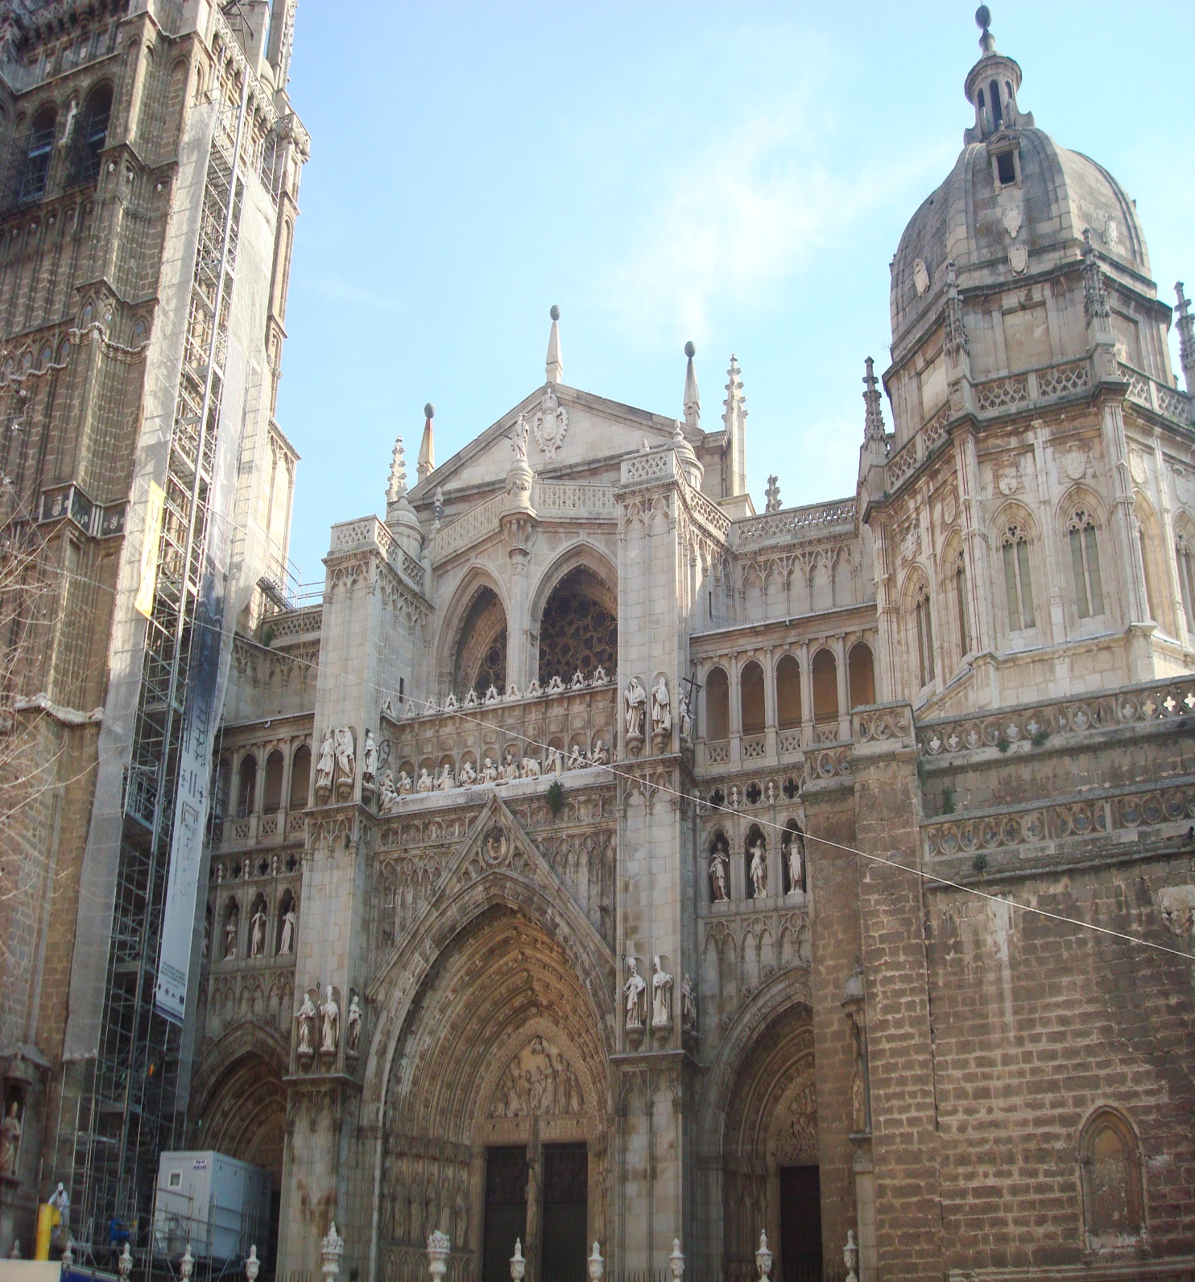
Synagogue of Santa María
la Blanca
-former synagogue, now museum

Slide 9
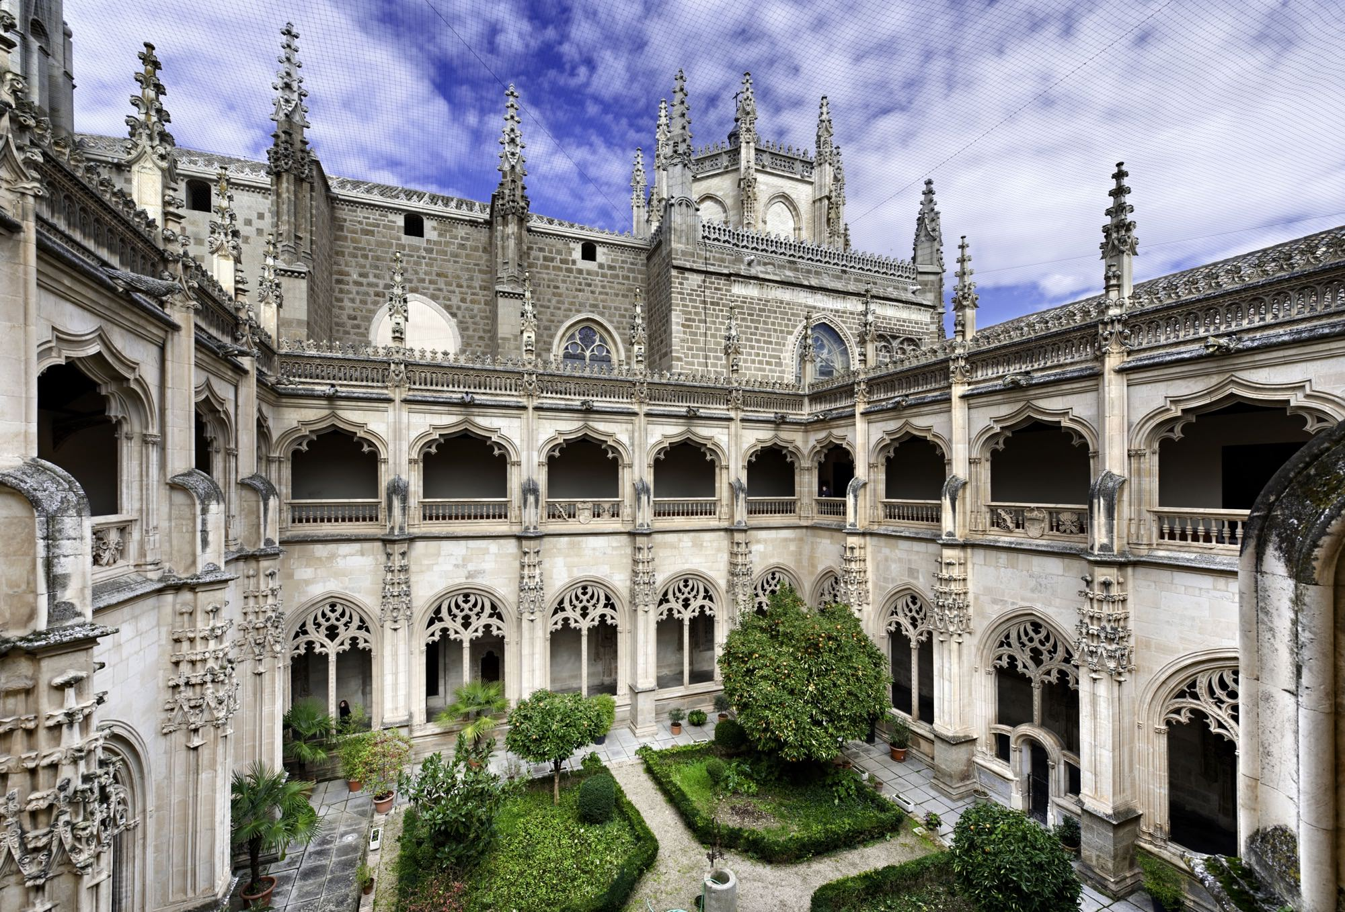
Monasterio de San Juan de los Reyes
- founded by King Ferdinand II of Aragon and Queen Isabella I of Castille to commemorate the birth of their son

