Slide 1
VALENCIA

Slide 2
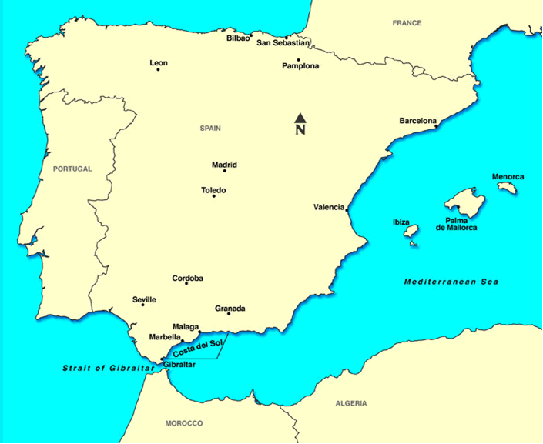
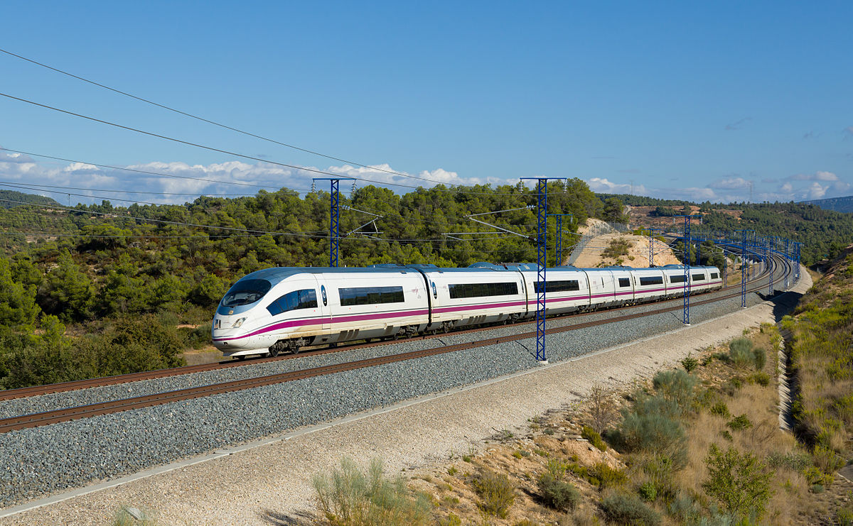
AVE -high speed train -193 mph

Slide 3
Guided Sightseeing Tour in VALENCIA

